Slide 1
Paying for College Get in the Game! 2019-2020
A presentation by the College Funding Project (with information adapted, in part, from the U.S. Department of Education)
The College Funding Project is an initiative of $tand By Me
in partnership with the Delaware Office of Higher Education
$tand By Me is a joint project of the State of Delaware and United Way of Delaware

Slide 2
But, you need to apply for it!
Money is available!

Slide 3
Minimum Application Requirements
At a minimum, you must:
Apply for admission
Submit the FAFSA (the “Free Application for Federal Student Aid”) at FAFSA.gov
BUT, there may be ADDITIONAL application(s) required by some schools or funding programs!

Slide 4
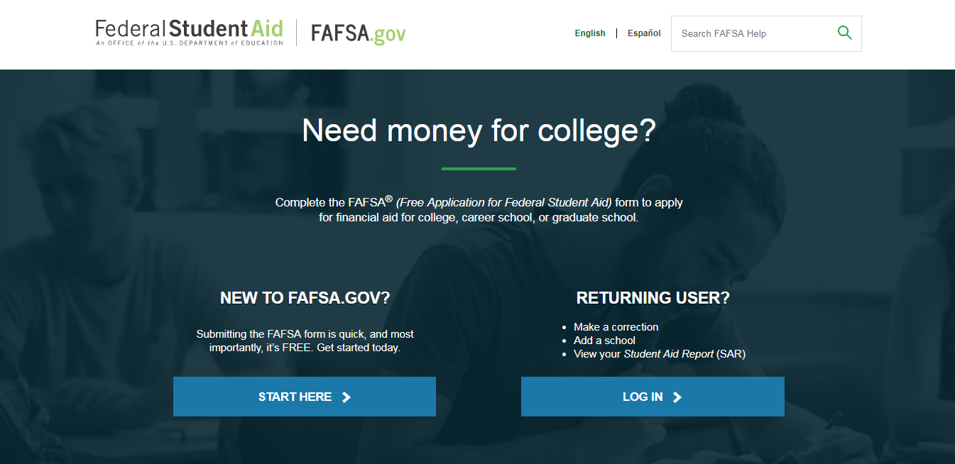
Money is
available if you
file the FAFSA!
What is the FAFSA?

Slide 5
FAFSA: Free Application for Federal Student Aid
FAFSA is where the game begins!
It’s the federal application used to collect demographic and financial information from students and parents
Must be filed online every year financial aid is needed at: FAFSA.gov
2019–2020 FAFSA available beginning: October 1, 2018
Uses income/tax data from your 2017 federal tax return(s)

Slide 6
Why do you have to submit the FAFSA?
FAFSA does …
FAFSA does NOT …
Determine student’s eligibility for federal student aid
Gather family’s income and asset information needed to calculate “Expected Family Contribution” (EFC)
Need to be submitted every year financial aid is needed
Collect information about household’s expenses or “special circumstances”
Determine what specific financial aid will be awarded
Determine how much financial aid will be awarded
Serve as loan application

Slide 7
Who is eligible for federal financial aid?
Student must be:
U.S. citizen or permanent resident with a valid Social Security number
Pursuing a degree or certificate AND enrolled at least half-time
In possession of high school diploma, GED certificate, or completed home schooling
Registered with Selective Service (males only)

Slide 8
DACA/Undocumented Students
You are:
Not eligible for FEDERAL financial aid under current federal law
Eligible for SEED scholarship at DTCC and UD
You should:
Contact the Financial Aid Office at each school you are considering and ask what funding options may be available to you at that school
Apply to “TheDream.US” scholarship program (DSU and other colleges)
Consider attending a DACA/Undocumented Student-friendly school, e.g., Swarthmore, Pomona, Oberlin, Tufts, Emory

Slide 9
What is the Expected Family Contribution (EFC)?
Amount government estimates that student/parent(s) should be able to contribute to cost of education
Same amount regardless of the school attended
Helps determine eligibility for “need-based” financial aid
But non-need based financial aid (e.g., federal student loans)
is available to help you replace the EFC, as needed!

Slide 10
Important FAFSA Reminders
Create separate Federal Student Aid IDs (FSA ID) for student and parent(s) at: FSAID.ed.gov
When you are ready to start filling out the FAFSA:
Go to: FAFSA.gov
Select “Start a New FAFSA”
Select “Start 2019-2020 FAFSA” to complete FAFSA for 2019-2020 academic year
Have your 2017 federal tax return/schedules and W-2 forms available if you filed a tax return(s)—you may need to enter information from them as you complete the FAFSA online
Complete ALL required sections of the online FAFSA; sign it and then submit it!
Create a FAFSA email folder on your computer so that you can store the confirmation and any subsequent emails your receive about your FAFSA
For assistance, call the U.S. Department of Education at 800-4-FED-AID, or $tand By Me at 302-255-9621.

Slide 11
FAFSA RESULTS:
Student Aid Report (SAR)
Student will receive a “Student Aid Report” (SAR) once the FAFSA has been processed
Student and parent(s) should review the SAR:
Check all information for accuracy; correct any errors
Update estimated information, if necessary
Update school listing, if necessary
Submit corrected/updated SAR, as needed

Slide 12
Parents and the FAFSA

Slide 13
Will parents’ information be needed on the FAFSA?
YES
NO
If student is: DEPENDENT
If student is: INDEPENDENT

Slide 14
Student is INDEPENDENT in 2019-2020 if …
Born before 1/1/1996
Married or separated
Grad/prof student
Serving on active duty
Veteran
Have dependent children
Have dependents other than children/spouse
Emancipated minor as determined by court
Someone other than parent or stepparent has legal guardianship as determined by a court (court papers must say ”guardianship" rather than ”custody")
Since age 13, both parents deceased, in foster care, or dependent/ward of court
As of 7/1/2018, determined to be unaccompanied youth who is homeless or at risk of being homeless
NOTE: Most high school seniors are DEPENDENT, and therefore, must provide parent(s) information on the FAFSA.

Slide 15
Who is “legal parent” on FAFSA?
“Legal parent” is the biological or adoptive parent
(or any individual listed as a “parent” on student’s birth certificate)
The following are NOT “legal parents” on FAFSA:
Grandparents
Aunts, uncles, or other relatives
Foster parents
Legal guardians

Slide 16
Do BOTH “legal parents” have to
provide information on FAFSA?
YES, if legal parents live together
NO, if legal parents do NOT live together:
Information must be provided by “custodial” parent – the parent with whom student lives with more of the year
AND, if legal parents are divorced AND “custodial” parent has remarried, information also must be provided by stepparent

Slide 17
What if student cannot obtain information from “legal parents”?
For example …
Parent(s) whereabouts is unknown
Parent(s) is/are not permitted to have contact with student
Then, “Special Circumstances” may exist …
Student must contact Financial Aid Office (FAO) at EACH school to which they are applying for admission/financial aid
FAO staff may be able to override dependency status so that student does not have to provide information from parent(s) on FAFSA

Slide 18
FSA ID
is required to sign the FAFSA

Slide 19
FSA ID —Your “Electronic” Signature
FSA ID is used to sign the FAFSA
Create your FSA ID (username and password) at: FSAID.ed.gov
You must have a valid Social Security number (SSN) to create your FSA ID. The SSN you use must match your name and birthdate on file with the Social Security Administration.
Both the STUDENT, and at least one PARENT need to create a unique FSA ID [parent(s) cannot sign FAFSA by using student’s FSA ID and student cannot sign FAFSA by using parent(s) FSA ID]
For assistance creating your FSA ID, call 1-800-4-FED-AID.
NOTE: Parent(s) who do not have a valid Social Security Number (SSN) are not able to create an FSA ID. Therefore, they must sign the FAFSA by printing out, signing and then submitting a signature page that is available in Section 6 of the online FAFSA application.

Slide 20
How much money is available?
Enough to cover the full
“cost of attendance,” if needed!

Slide 21
Cost of Attendance (COA)
The “Sticker Price”
Calculated by school
Can vary by school/residency/major
Includes BOTH tuition/fees and living expenses for academic year
Total financial aid cannot exceed “Cost of Attendance”
Not prescriptive
COA Elements
Tuition
Fees
Books and Supplies
Room and Board
Transportation
Clothing
Misc. Personal Expenses

Slide 22
What will it cost YOU?
“Sticker Price”
(Cost of Attendance)
−
Scholarships/grants
(“Free” Money)
=
“Net Cost” to you
Federal Work Study and Federal Direct Loans
can be used to cover the “net cost,” as needed

Slide 23
What types of funding are available?

Slide 24
Types of Financial Aid
Scholarships
and Grants
Work Study
Loans

Slide 25
Scholarships and Grants
This is the FREE money – you do not have to pay it back!
Find out how and when to apply—you must at least complete the FAFSA (other applications also may be required—ask the schools).
Need-based federal and state GRANTS may be available to students with high need.
How well you do in high school may impact how much in merit-based SCHOLARSHIP funding you are awarded.
Make sure you understand the “fine print” – for example, will the grant/scholarship be renewed each year?

Slide 26
Federal Work Study (FWS)
This is money you can earn from part-time employment while you are in school!
Make sure you answer YES to question on the FAFSA asking if you want to be considered for FWS funding (you can always change your mind after you are in school).
Jobs typically are on campus and may offer greater flexibility in your work schedule.
Part-time employment may still be available if you are not eligible for FWS funding, but they may be harder to find and more likely will be off-campus and have less flexible hours.

Slide 27
Loans
This is money you (and your parents) can borrow—it must be paid back after you finish school!
Loans are used to fill any funding gap.
Always borrow federal loans first!
Repayment of federal loans is very flexible—monthly payments can be based on your income rather than amount of your debt
Borrow the minimum amount you need to attend your chosen school.

Slide 28
Current Federal Aid Programs
Grants
Employment
Federal Pell Grant
Federal Supplemental Educational Opportunity Grant (SEOG)
Teacher Education Assistance for College and Higher Education (TEACH) Grant
Federal grant funding could total more than $6,000/year depending on your situation
Federal Work-Study
Loans
STUDENTS:
Direct Subsidized Loan
Direct Unsubsidized Loan
PARENTS:
Direct PLUS Loan
Federal loan funding could cover up to COA minus all other financial aid, if needed

Slide 29
Current Delaware Programs
Scholarships and Grants
SEED Scholarship – merit-based award for use if enrolled in Associate’s degree program at either Del Tech or UD
INSPIRE Scholarship – merit-based award for use at Del State University
Memorial Scholarships – merit based award for use at UD/Del State
Diamond State Scholarships -- merit based award for use at any college/university in US
Scholarship Incentive Program (ScIP) Grants -- need-based award for use at any college in Delaware or as part of “Academic Common Market”

Slide 30
Delaware Application Requirements 2019-2020 Delaware Scholarships/Grants
Complete the FAFSA and submit it so that it is received by the federal processor by April 15, 2019
Create your “Student Account” at: https://www.doe.k12.de.us/Page/1953
Complete the following additional form for the Memorial/Diamond State merit-based awards funded by the State of Delaware:
Common Merit Application -- application is available at: DelawareGoestoCollege.org
Complete any additional requirements specified by the school.

Slide 31
When do you apply?

Slide 32
When do you file the FAFSA?
Do NOT wait until you have been offered admission—you could miss important deadlines established by the school you want to attend
You can submit the FAFSA beginning OCTOBER 1st of the calendar year before you start college
For example, the 2019–2020 FAFSA is available on October 1, 2018 (uses income/tax data from 2017 federal tax return)

Slide 33
Final comments

Slide 34
Financial Aid Application Checklist
Create separate Federal Student Aid IDs (FSA ID) for student and parent(s) at: FSAID.ed.gov
Create a “Student Account” to access student’s account for Delaware state funding at:
https://www.doe.k12.de.us/Page/1953
Complete and submit the FAFSA as soon as possible after October 1, 2018 (include both student & parent information, as needed)
Contact the Financial Aid Office at each school; ask if any other materials/information are needed; explain any SPECIAL CIRCUMSTANCES student/family may have that will impact your ability to pay for school
Review Financial Aid Award notification when received from school(s) and respond as needed/instructed to complete the process
Apply for any federal loan funding that is needed (as instructed by the school you decide to attend)
Continue researching and applying for privately-funded scholarships

Slide 35
“I submitted my FAFSA – I’m done!”
Triple-check (website, portal, call) to ensure that you have successfully submitted all required information for financial aid.
Create an e-mail folder for every potential college and a general folder for Financial Aid. Keep confirmations in these folders.
Watch for notification that FAFSA has been processed--student will receive an e-mail stating that the FAFSA was “successfully processed.”
Meet all deadlines.

Slide 36
How will you know what financial aid
you are eligible to receive?
The Financial Aid Office will notify you of the types and amounts of financial aid you are eligible to receive as soon as possible after:
You have been admitted to the school
You have submitted your FAFSA and all other required financial aid application materials
You will need to follow the directions provided by the school to complete the process (including applying for any loans you need to borrow)

Slide 37
Useful Tools …
“FAFSA4caster” available at: FAFSA.gov
“Net price calculator” for the college you want to attend—search tool available at: CollegeCost.ed.gov
“College Scorecard” available at: CollegeScoreCard.ed.gov

Slide 38
For more information . . .
College admission and financial aid staff
High school guidance counselor
Online resources:
StudentAid.gov
FAFSA.gov
DelawareGoestoCollege.org
GIBill.va.gov
StandByMeDE.org

Slide 39
Remember, paying for college starts today, so get in the game!
Money is available, but you need to file the FAFSA!
Be strategic, start preparing now!
StandByMeDE.org

